Slide 1
React hooks
Sriram Ravichandran
digi0ps

Slide 2
WHO am i?

Slide 3
What will I be talking about?
The time before Hooks
What is Hooks and what it tries to solve
The inbuilt/default hooks
Creating a custom hook
Rules of hooks
Things I don’t like about hooks
Notes:
Just give a few examples when talking about default hooks

Slide 4
How Did I learn Hooks?
Notes:
humorous take on how popular hooks were and I kept delaying the process
Decided to a college project that I will do it completely with hooks

Slide 5
How was it before hooks?
State and Props
Two ways of writing components
Functional
Class
Functional can only use props, no state.
If a component needed state, it had to be a class component. (or shift state to external state management libraries like Redux)
Notes:
State and Props were two of react’s core concepts, they were what gave React there reactivity
As you all know, there were two ways of writing react components
I was used to this approach, I followed this strategy of using class components as logic containers where all the state logic resided and the functional components were dumb which means they would just be used for displaying content from props.

Slide 6
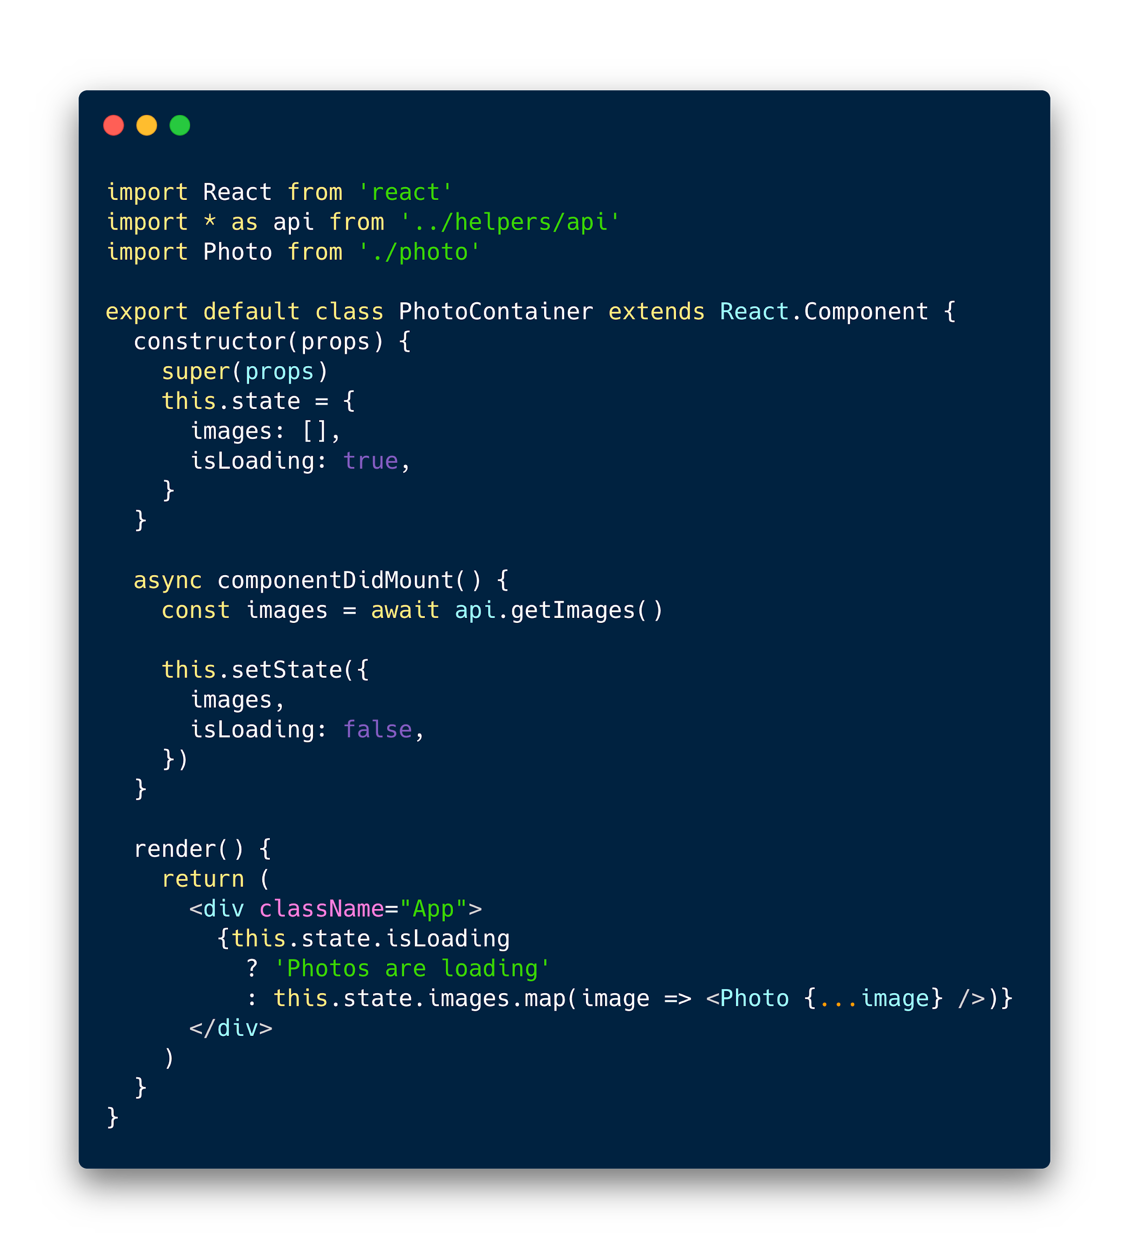
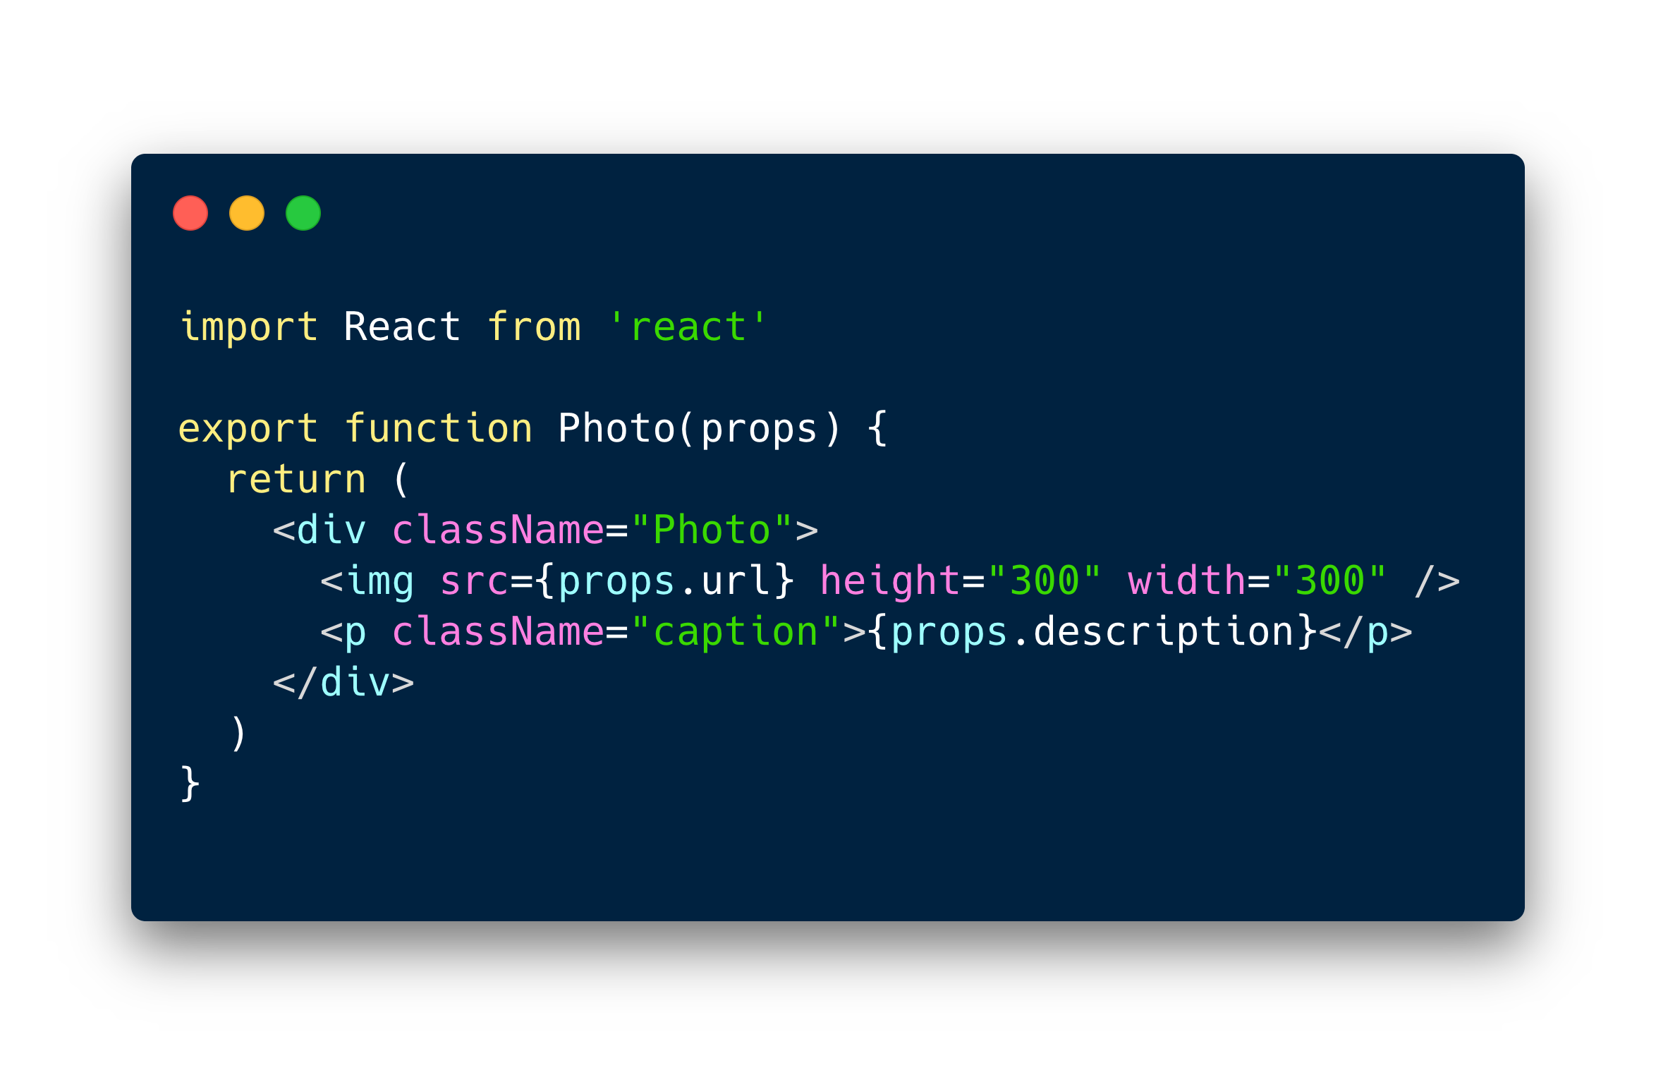
Functional Component
<-- Class Component

Slide 7
So what is hooks? and how does it solve this?
Introduced in React 16.8
Special Functions
Lets you use state and other React features inside functional components.
Totally new API, doesn’t break anything
Helps separate and reuse state logic
Notes:
Hooks don’t replace your knowledge of React concepts. Instead, Hooks provide a more direct API to the React concepts you already know
More on this later

Slide 8
Let’s dive in
Notes:
I will be taking you guys through a small react app which was built using classful state features and refactoring them as we go

Slide 9
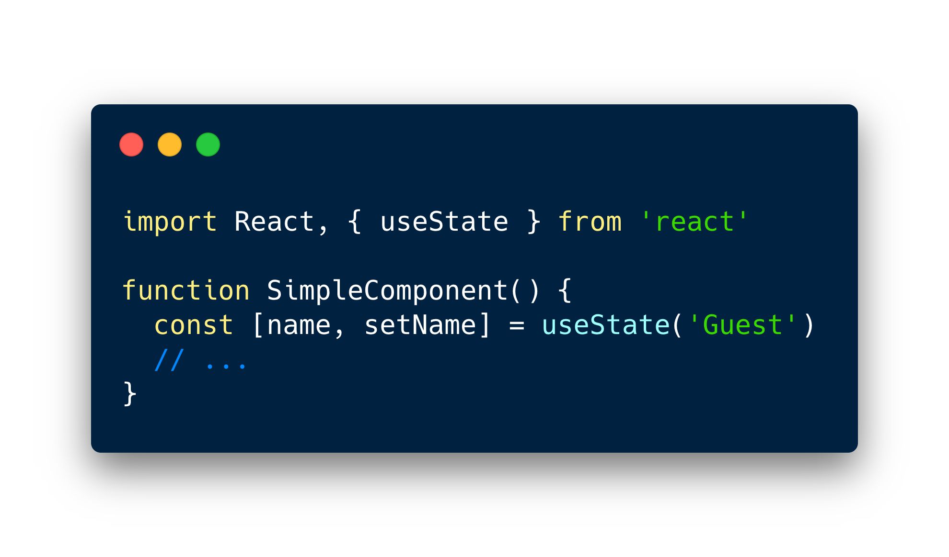
useState()
Declares a state variable
Takes in the initial state as argument
Primitive or an Object
Returns an array pair; the state value and a function to update the state

Slide 10
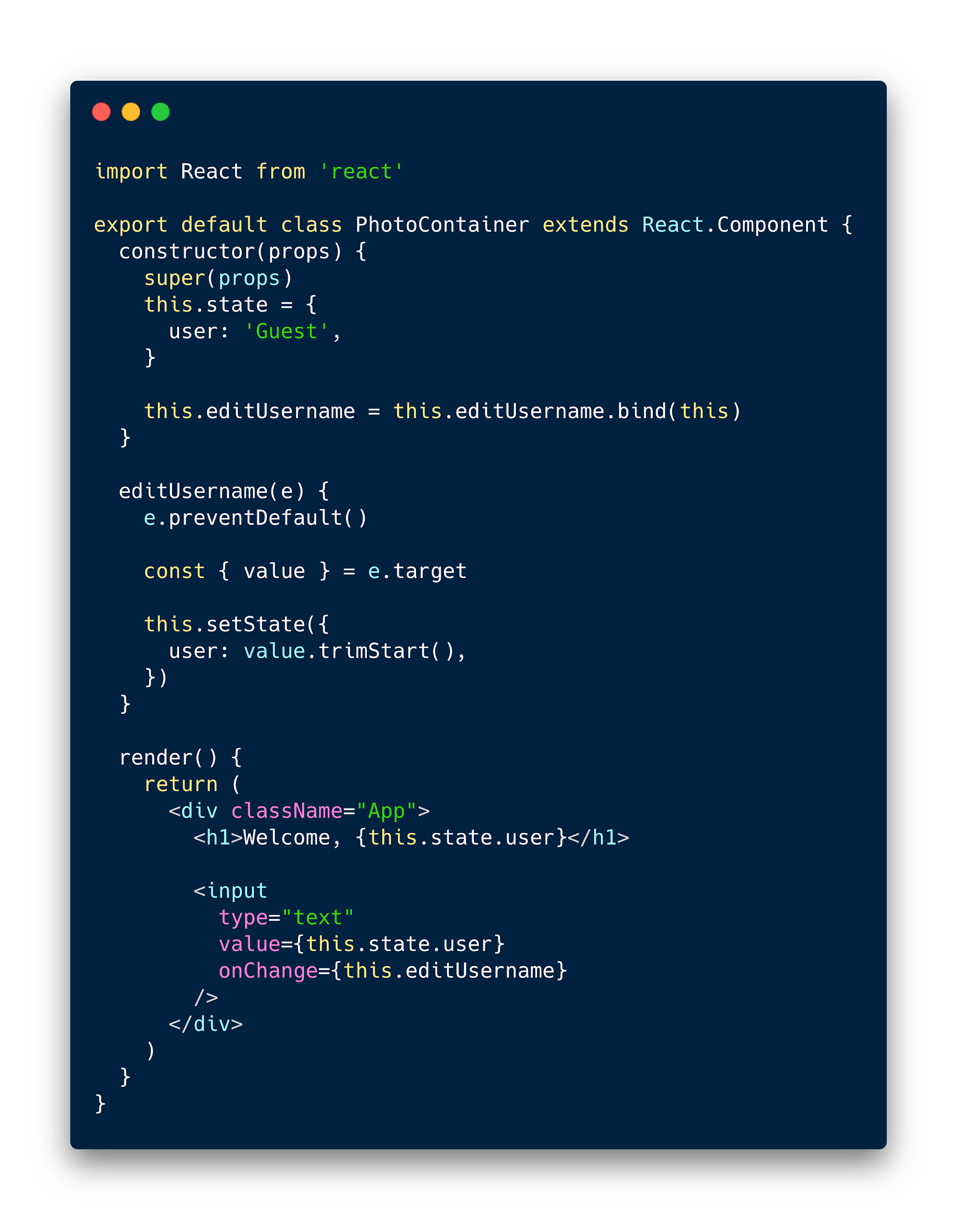
A class example with a simple user state being edited in an input

Slide 11
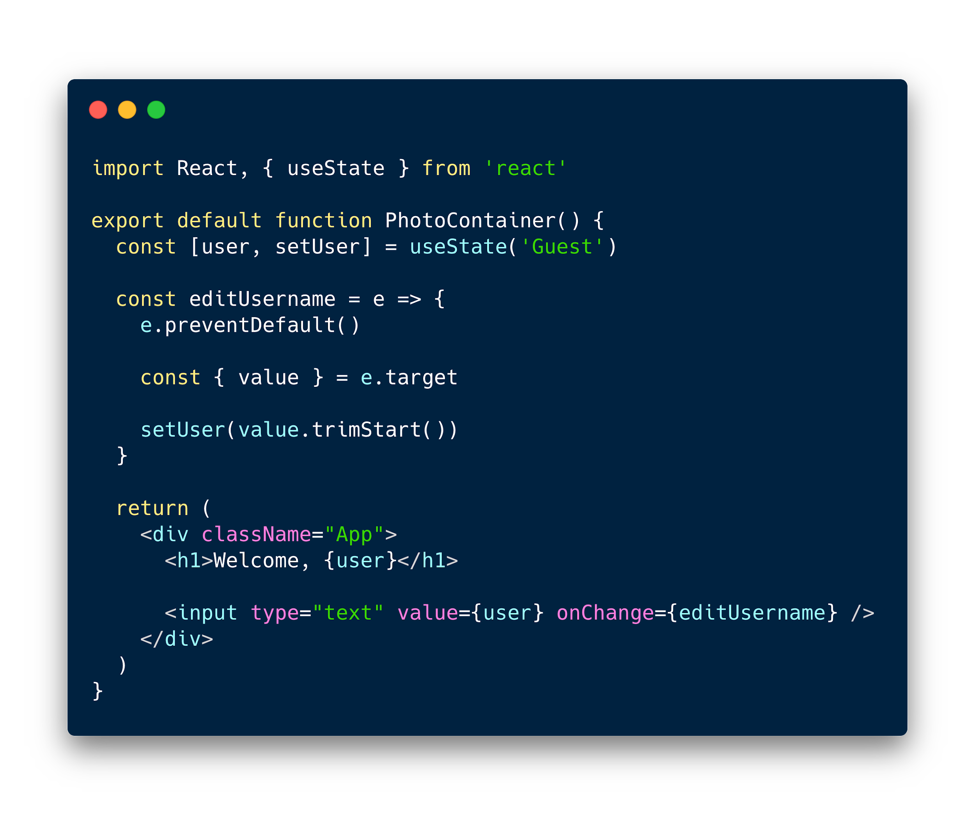
Now the same component written in hooks.

Slide 12
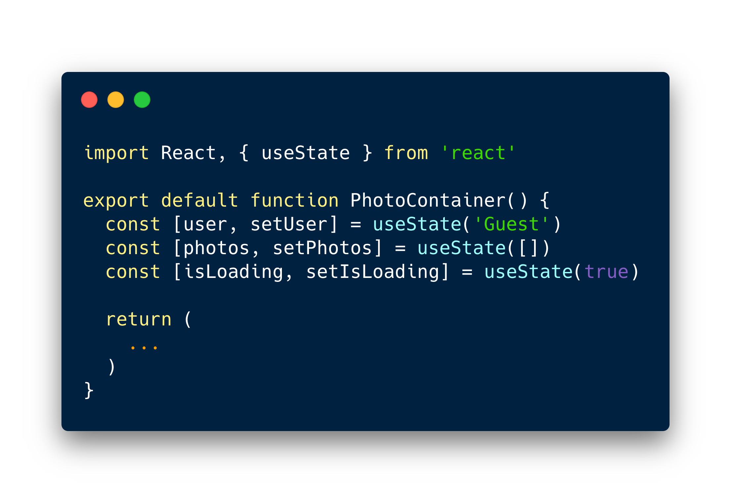
Multiple state can be written as multiple hooks
Notes:
Cue into how we will do the load content as we did in componentDidMount

Slide 13
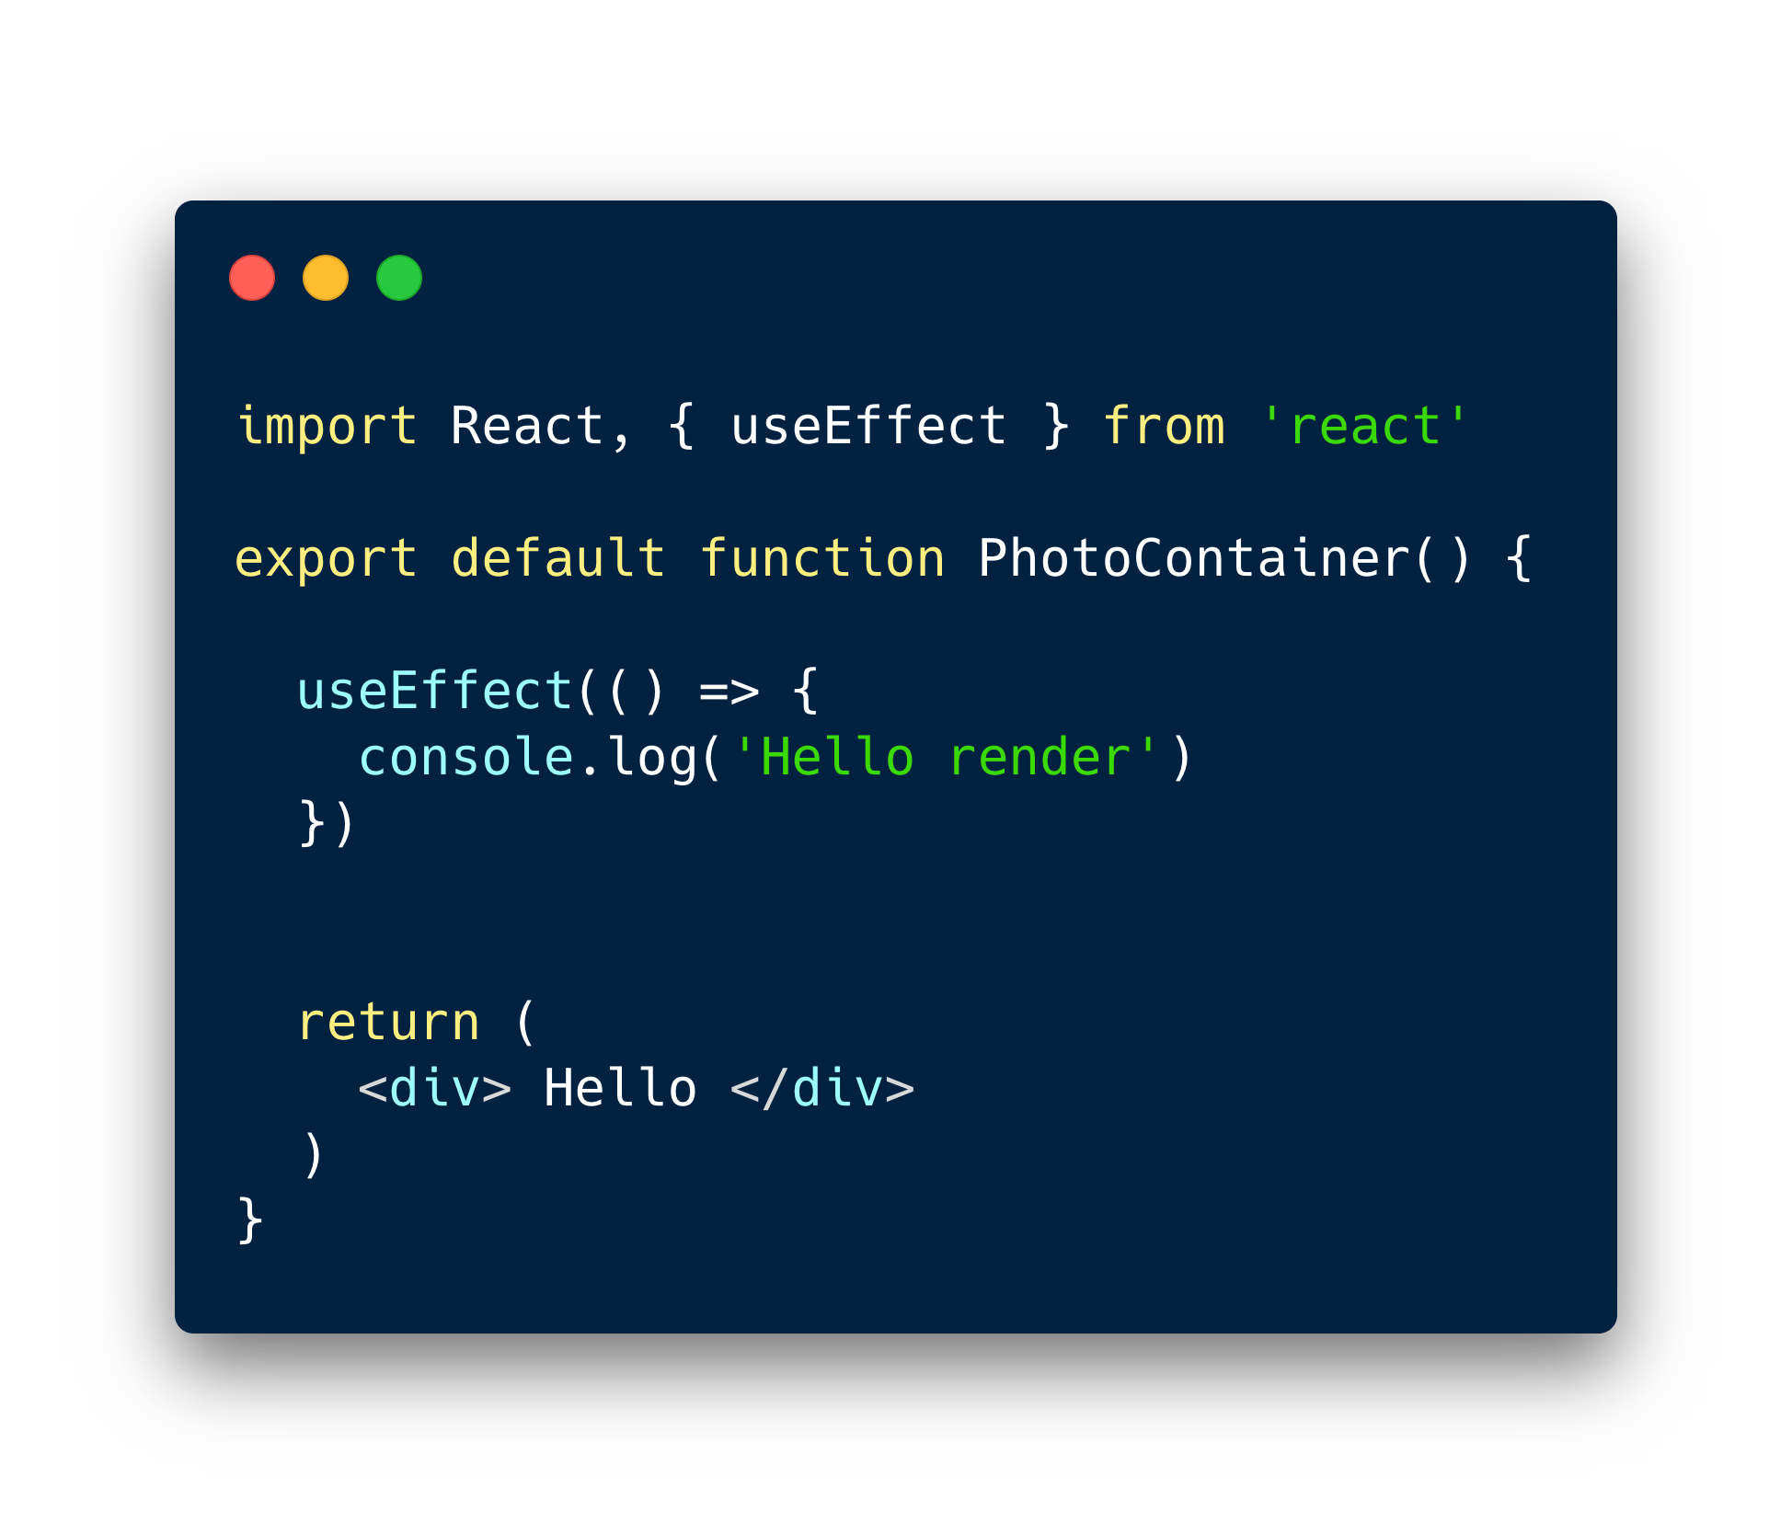
useEffect
Takes in a function as the first arg (aka side effect)
Dependency array as the second arg
Runs the function on every render or whenever the dependency list changes.

Slide 14
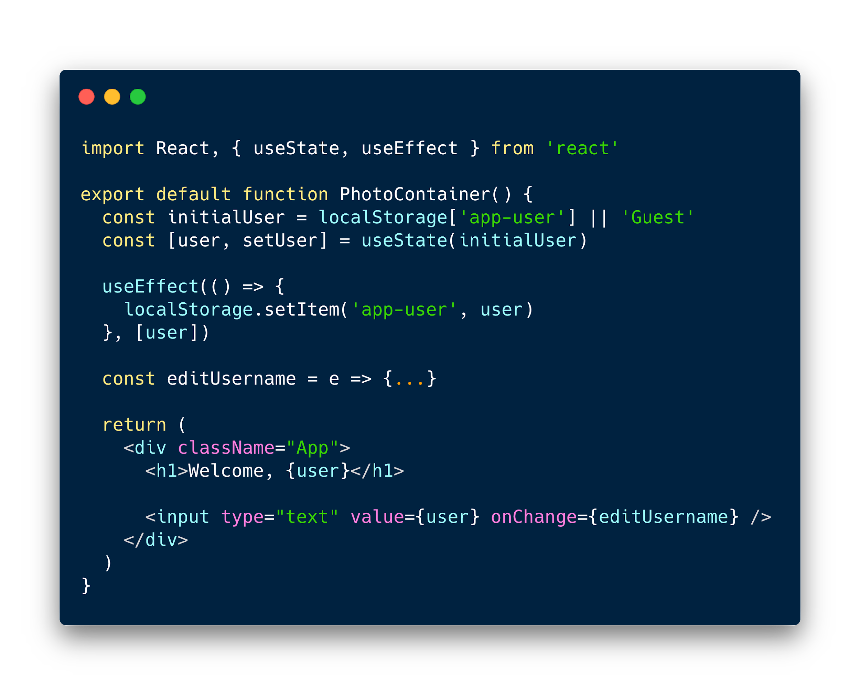
Runs effect only when the state “user” changes

Slide 15
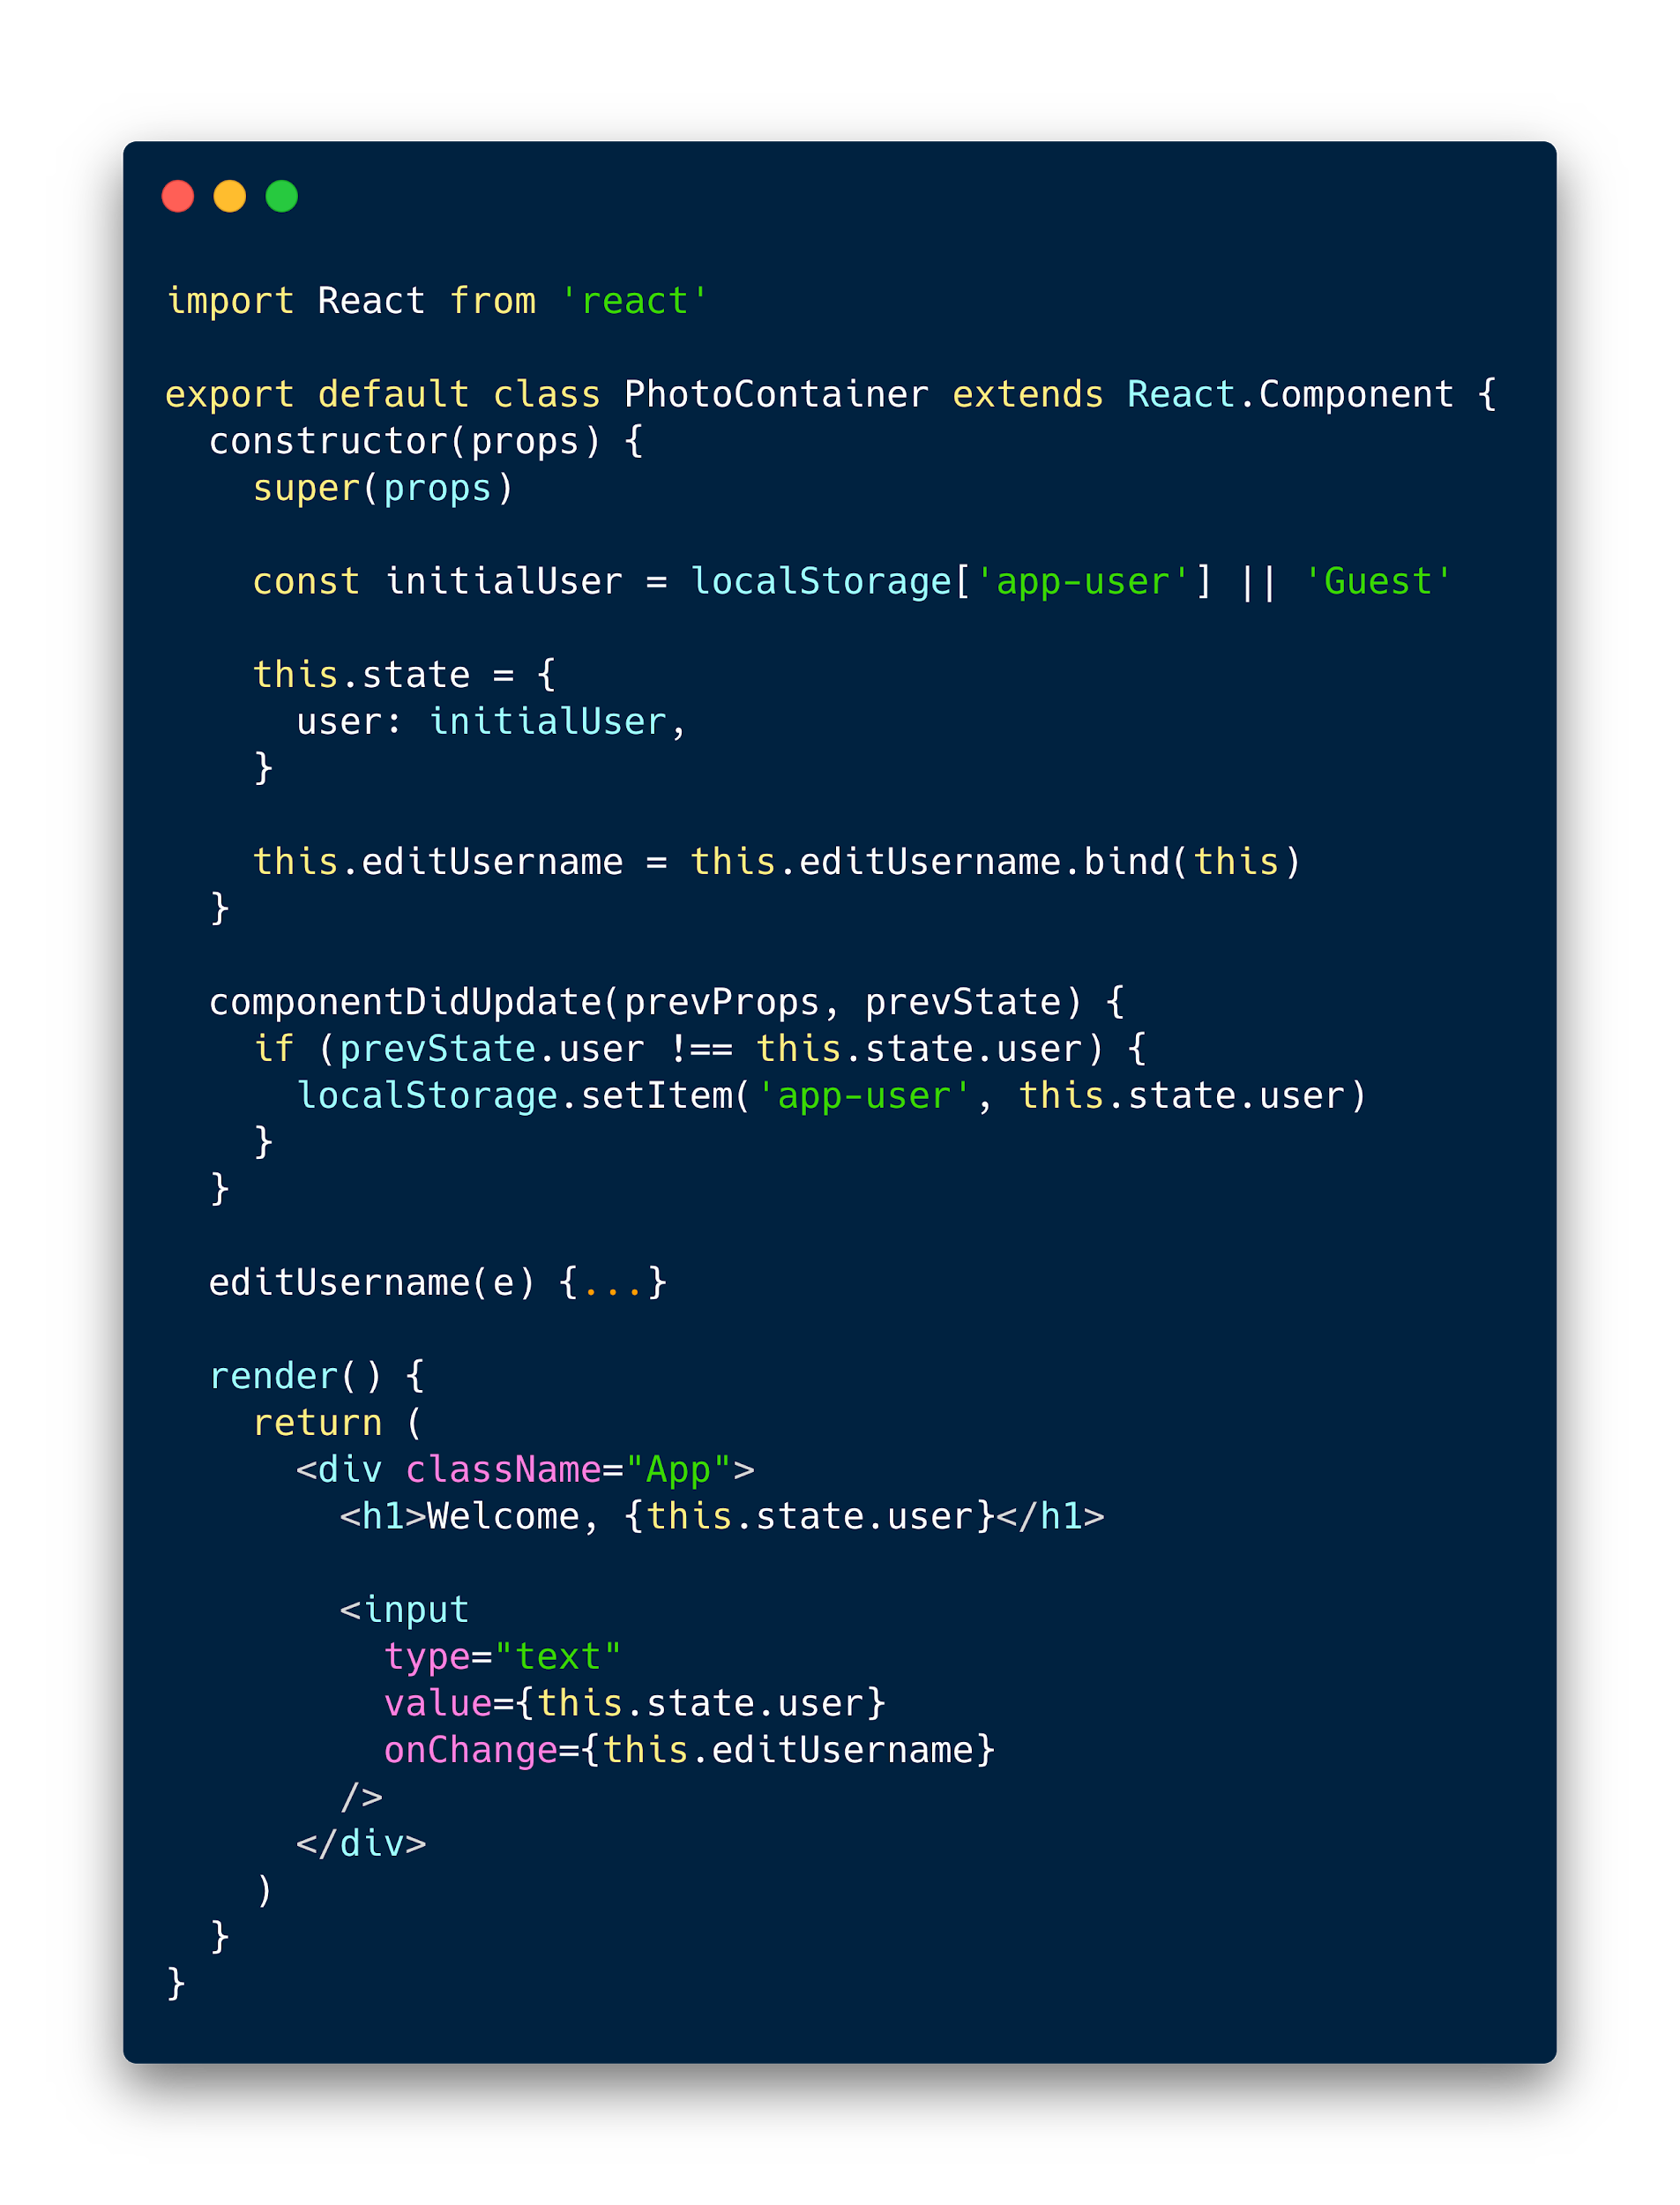
The same code in a class component.

Slide 16
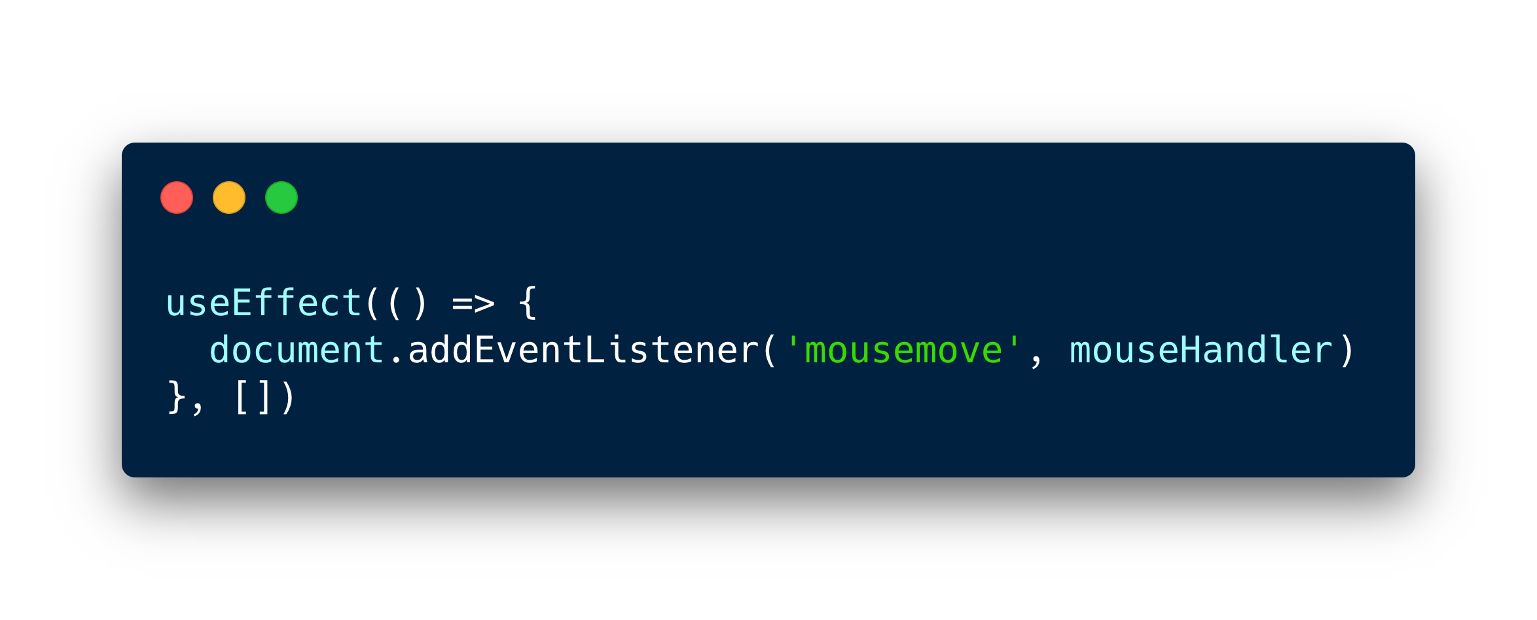
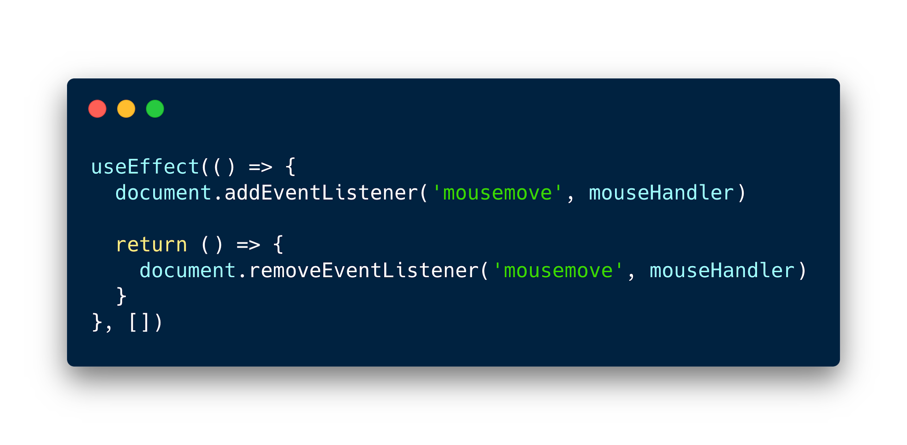
What about running effect at mount / unmount?

Slide 17

But what about async stuff like this?
Notes:
Like this class component which is fetching some data at startup

Slide 18
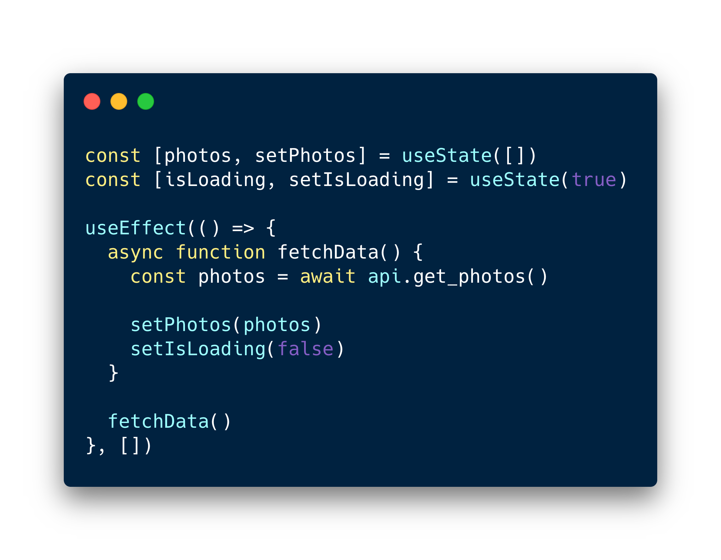
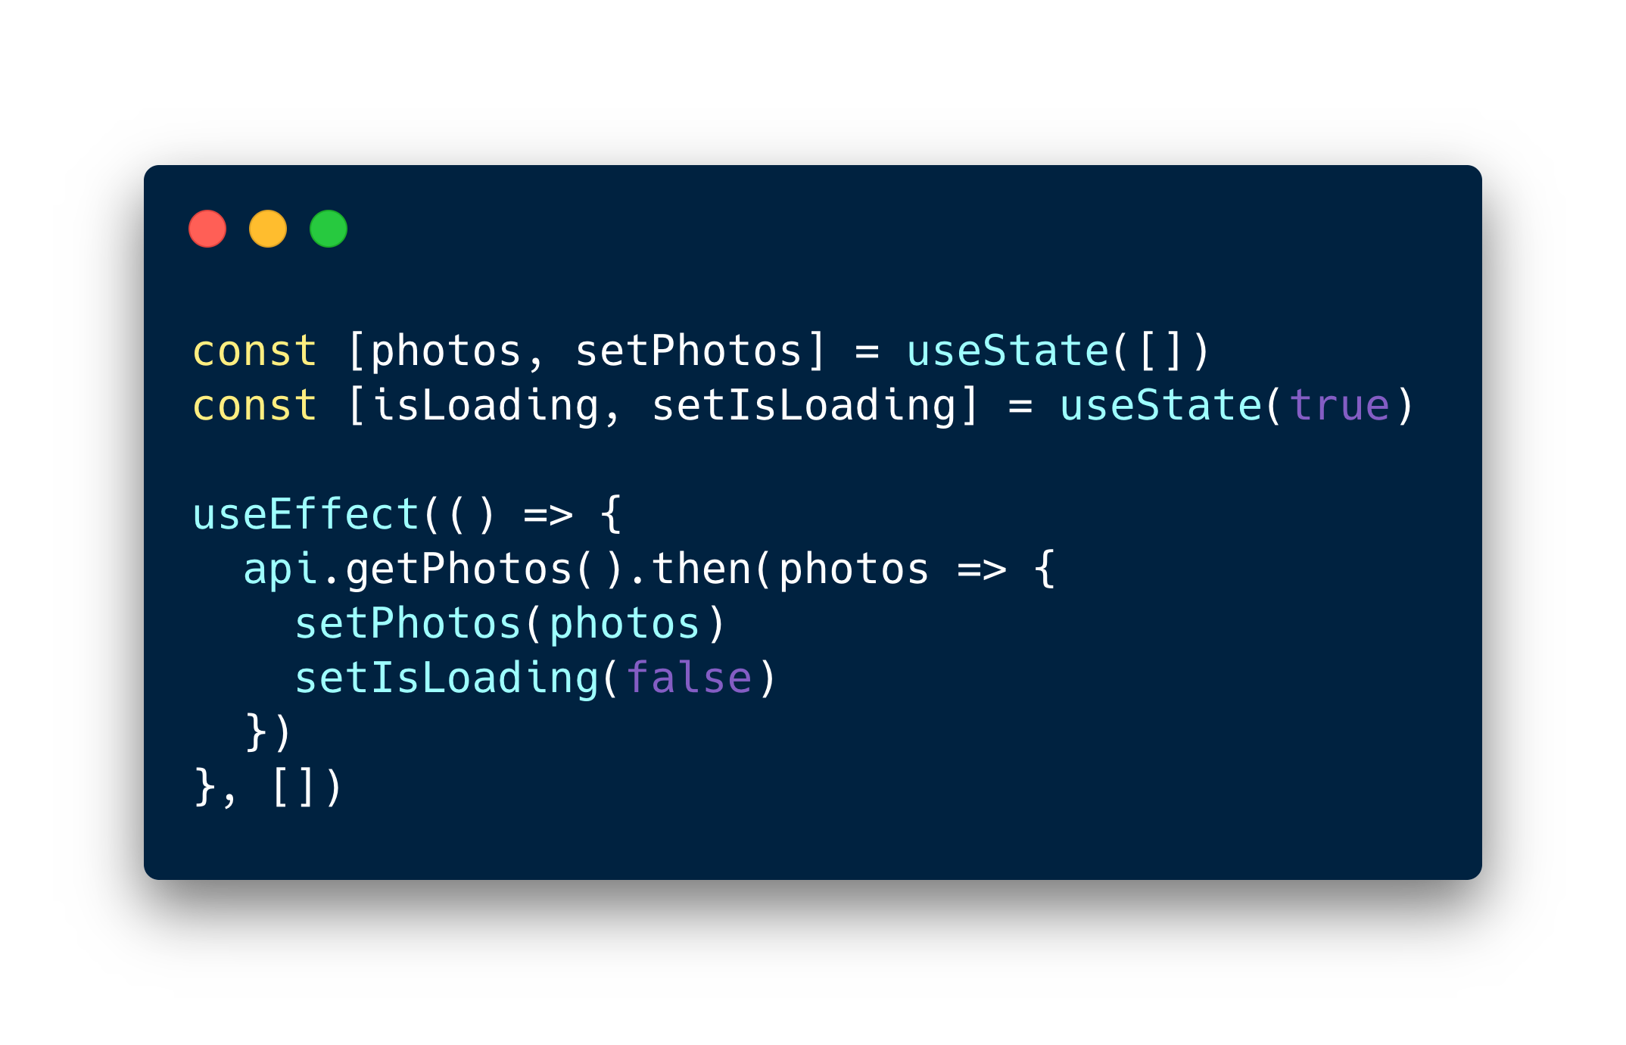
Async JS in useEffect
Promises
Async/Await

Slide 19
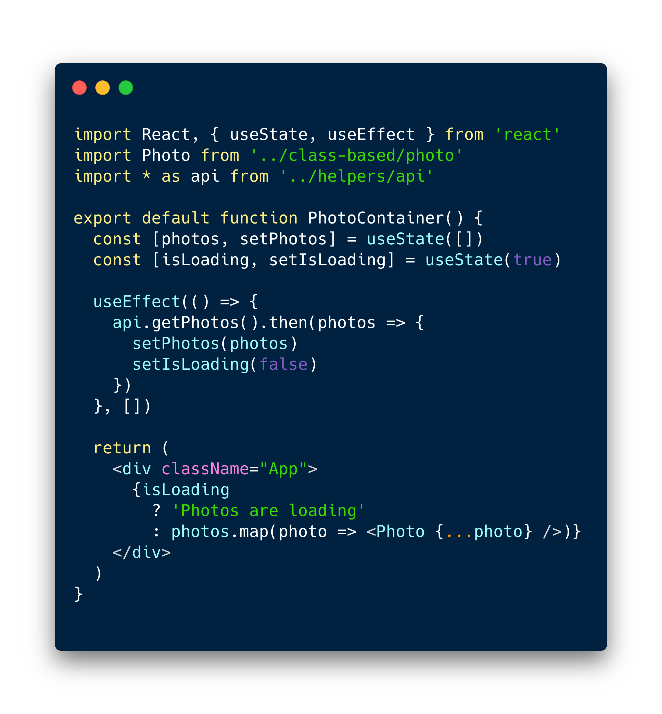
Custom hooks
Functions that start with “use”
Can call other hooks inside
Let’s you extract component logic into reusable functions

Slide 20
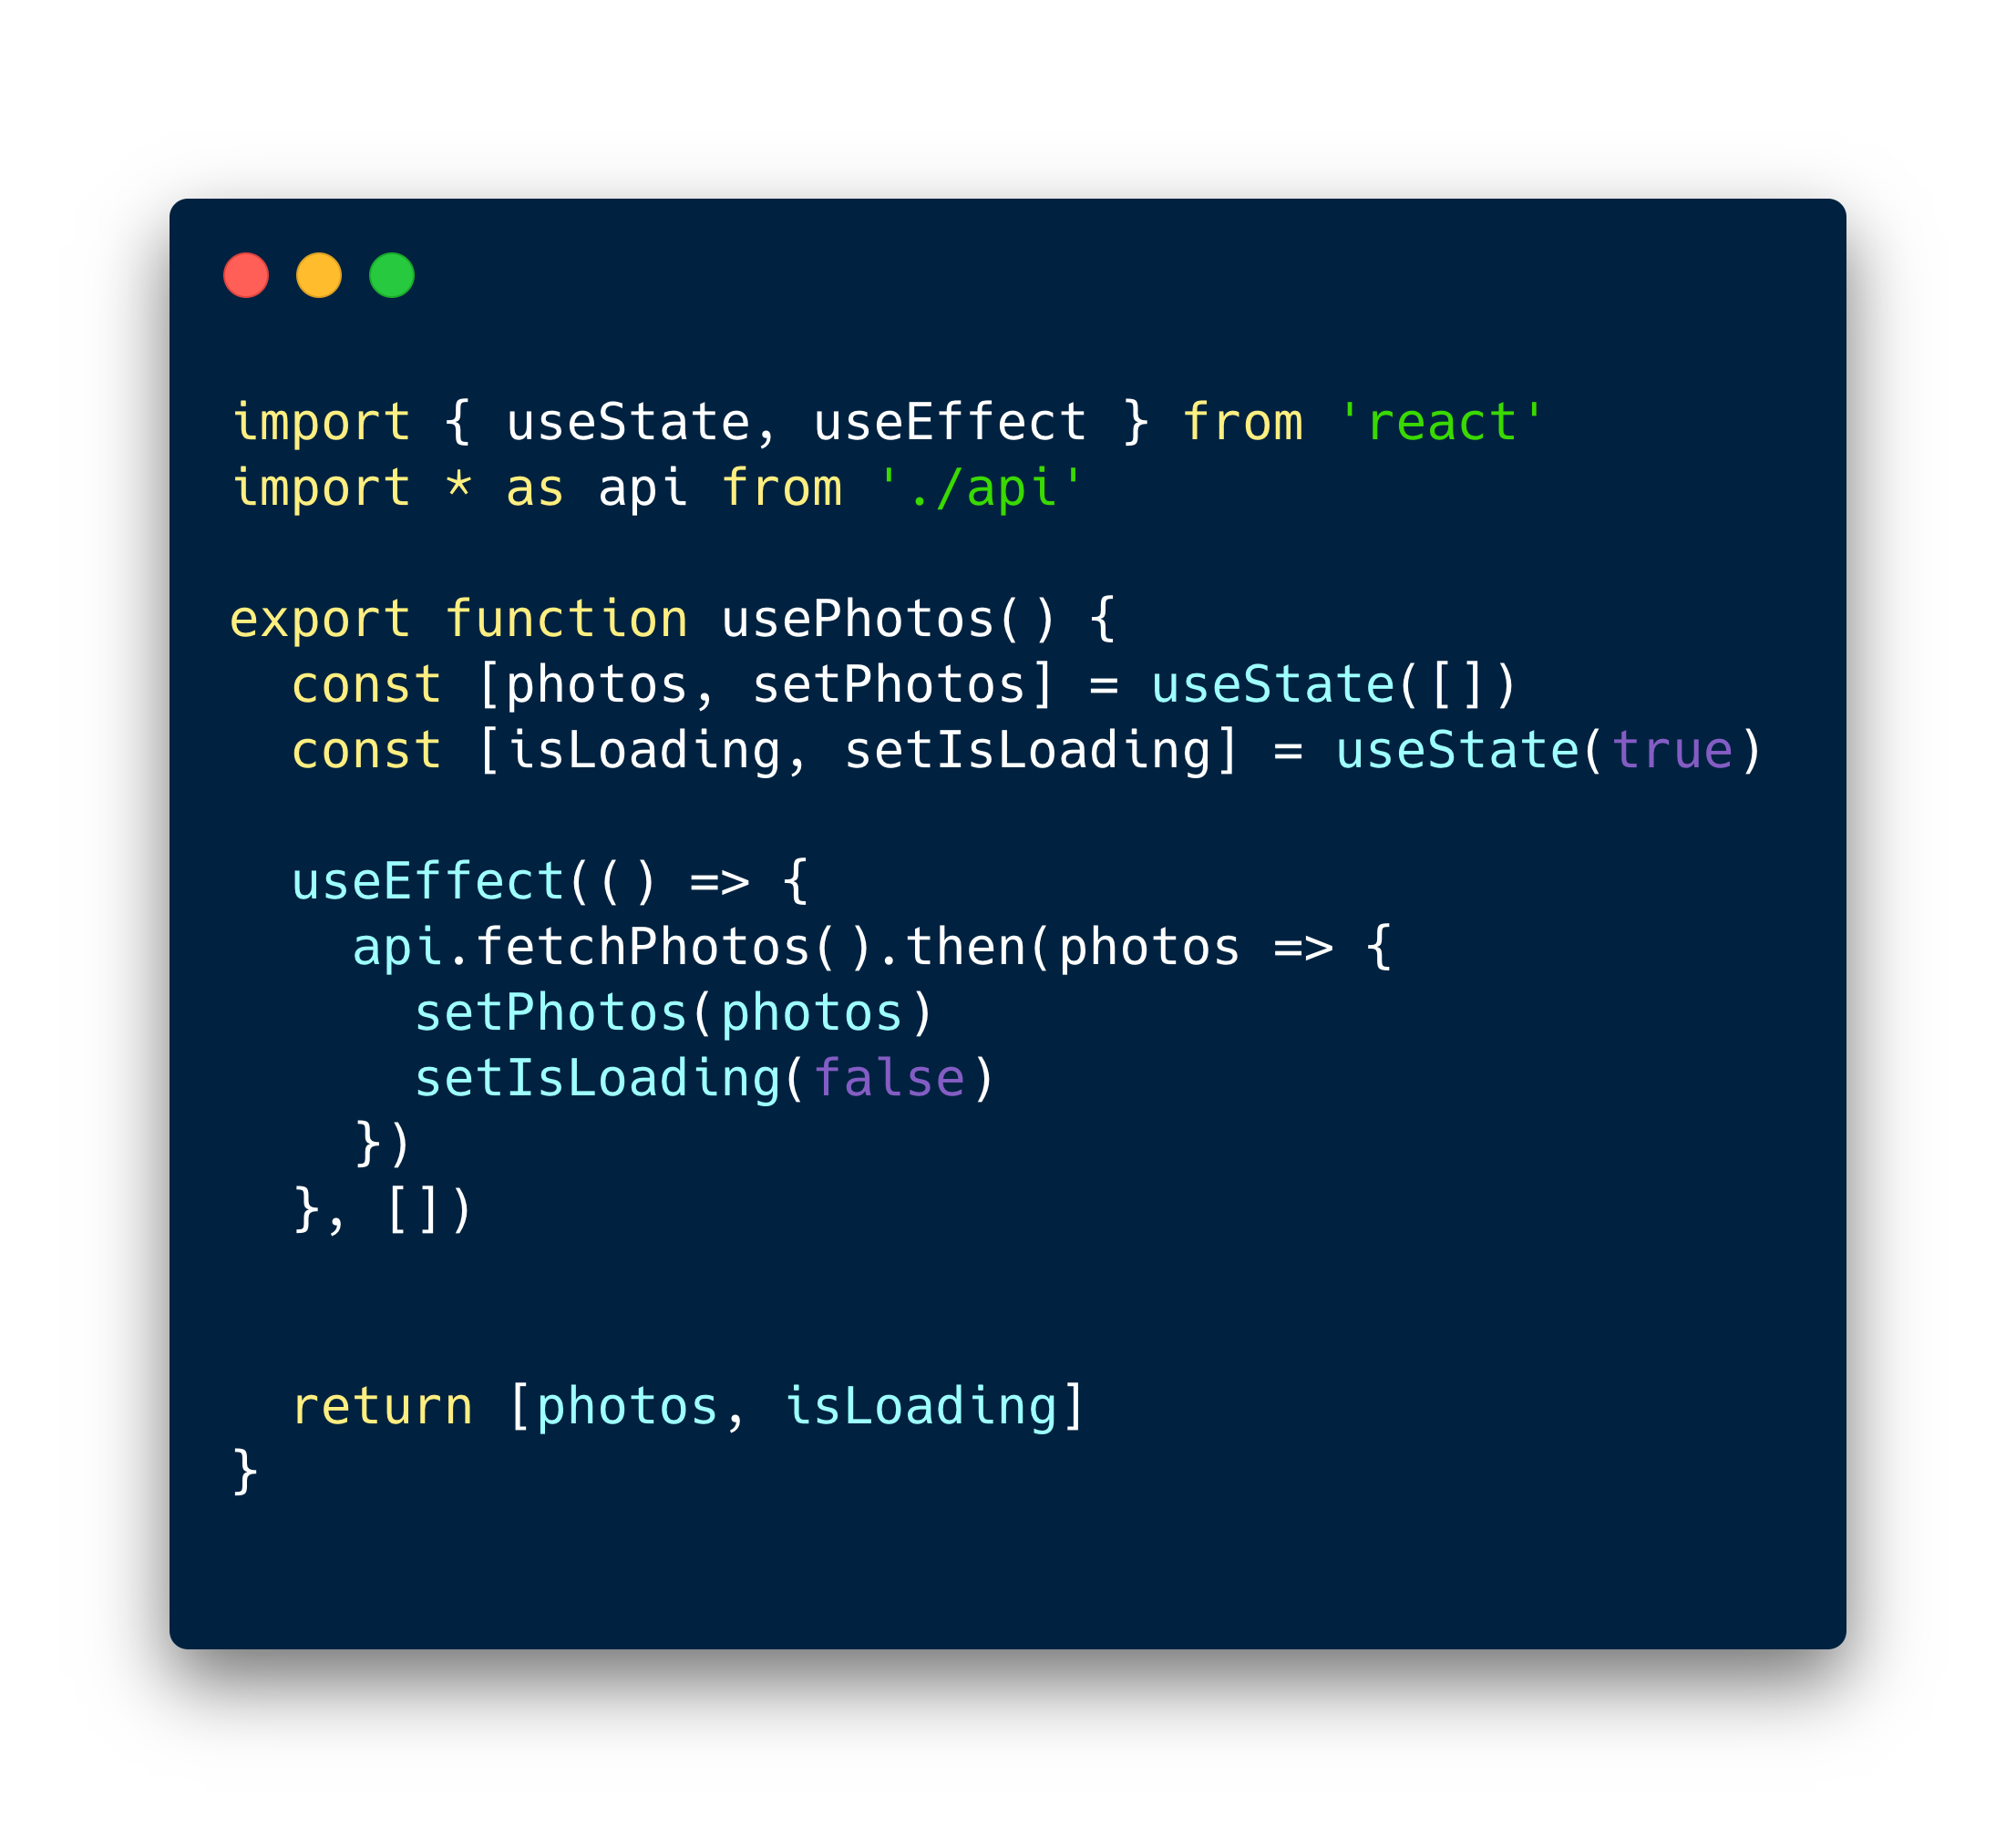
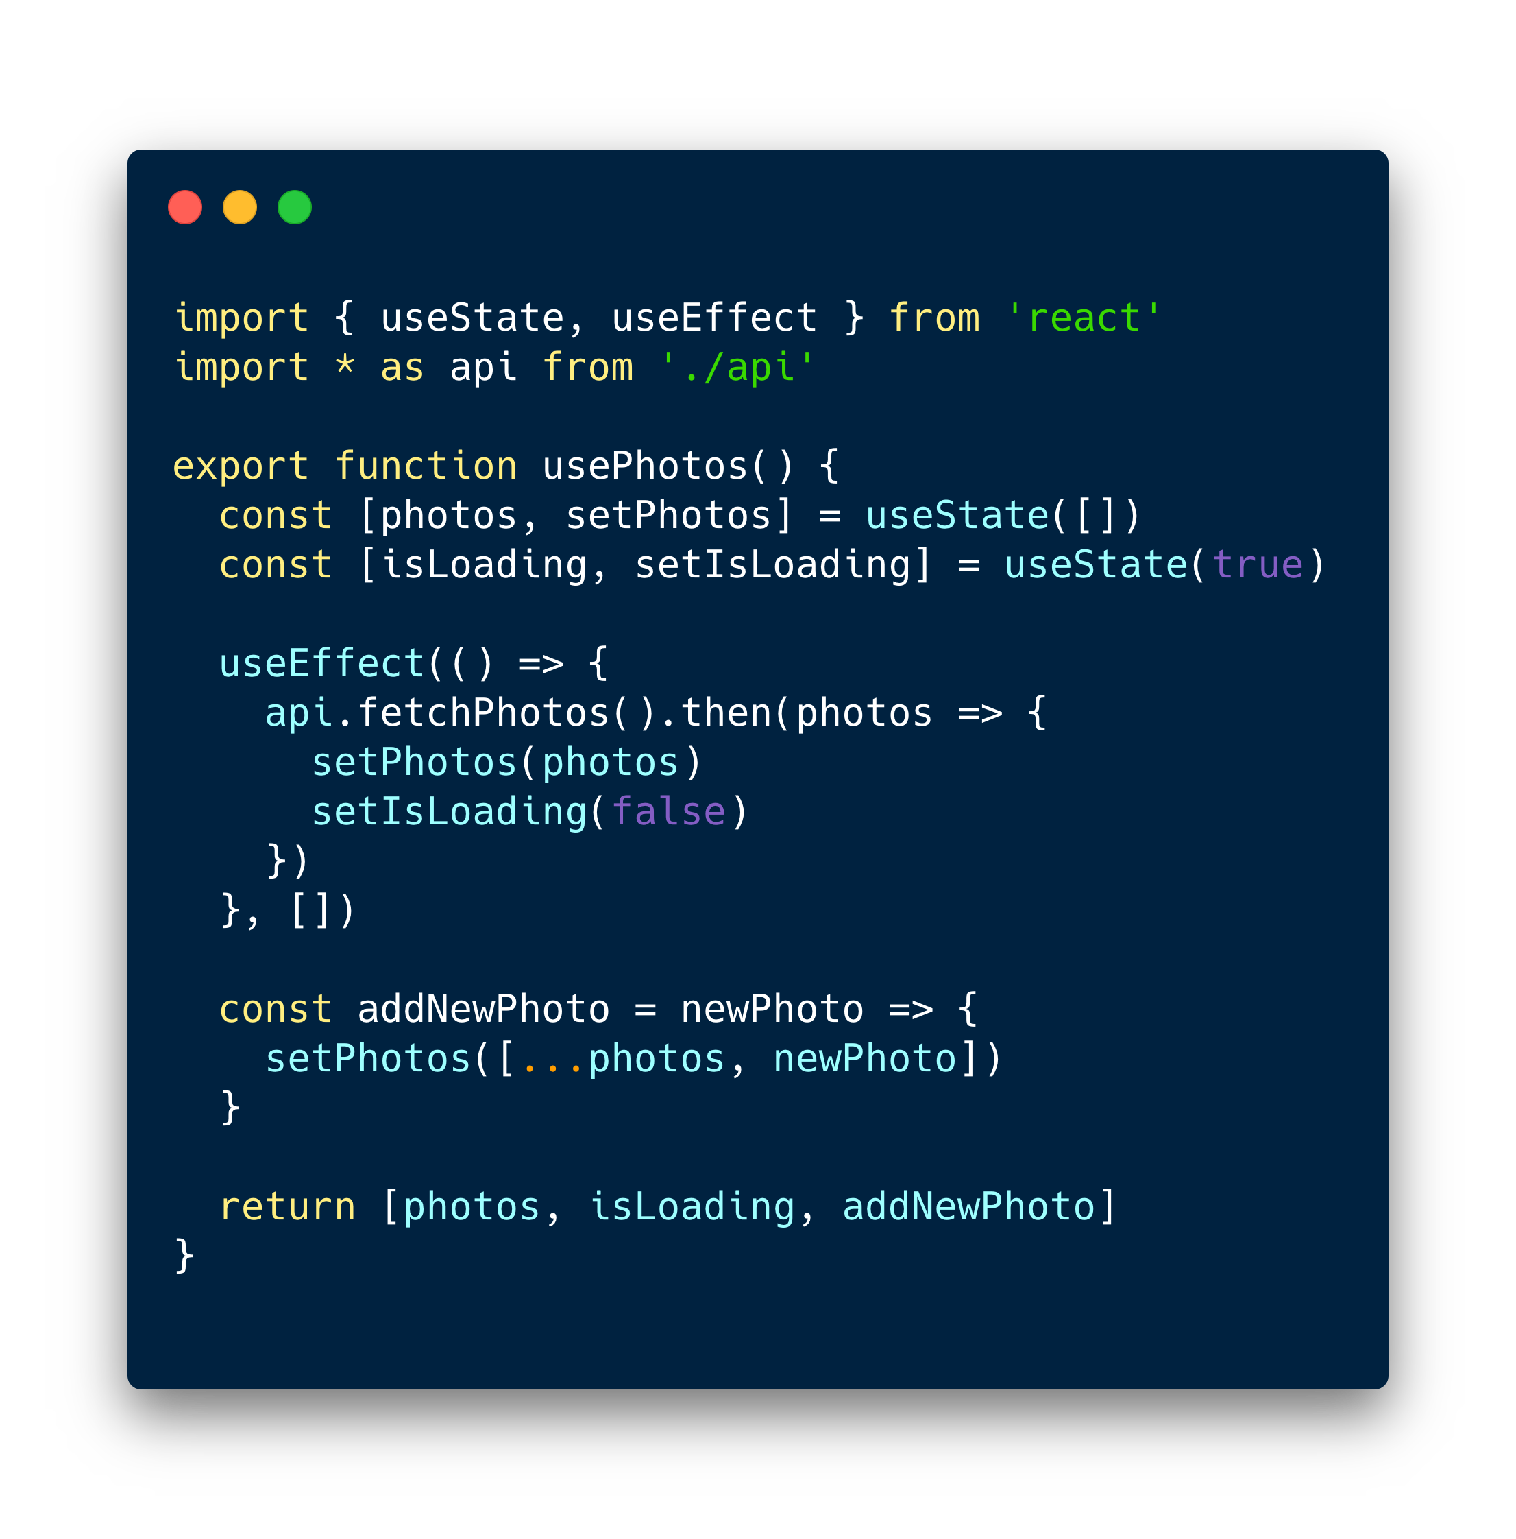
Custom hooks

Slide 21
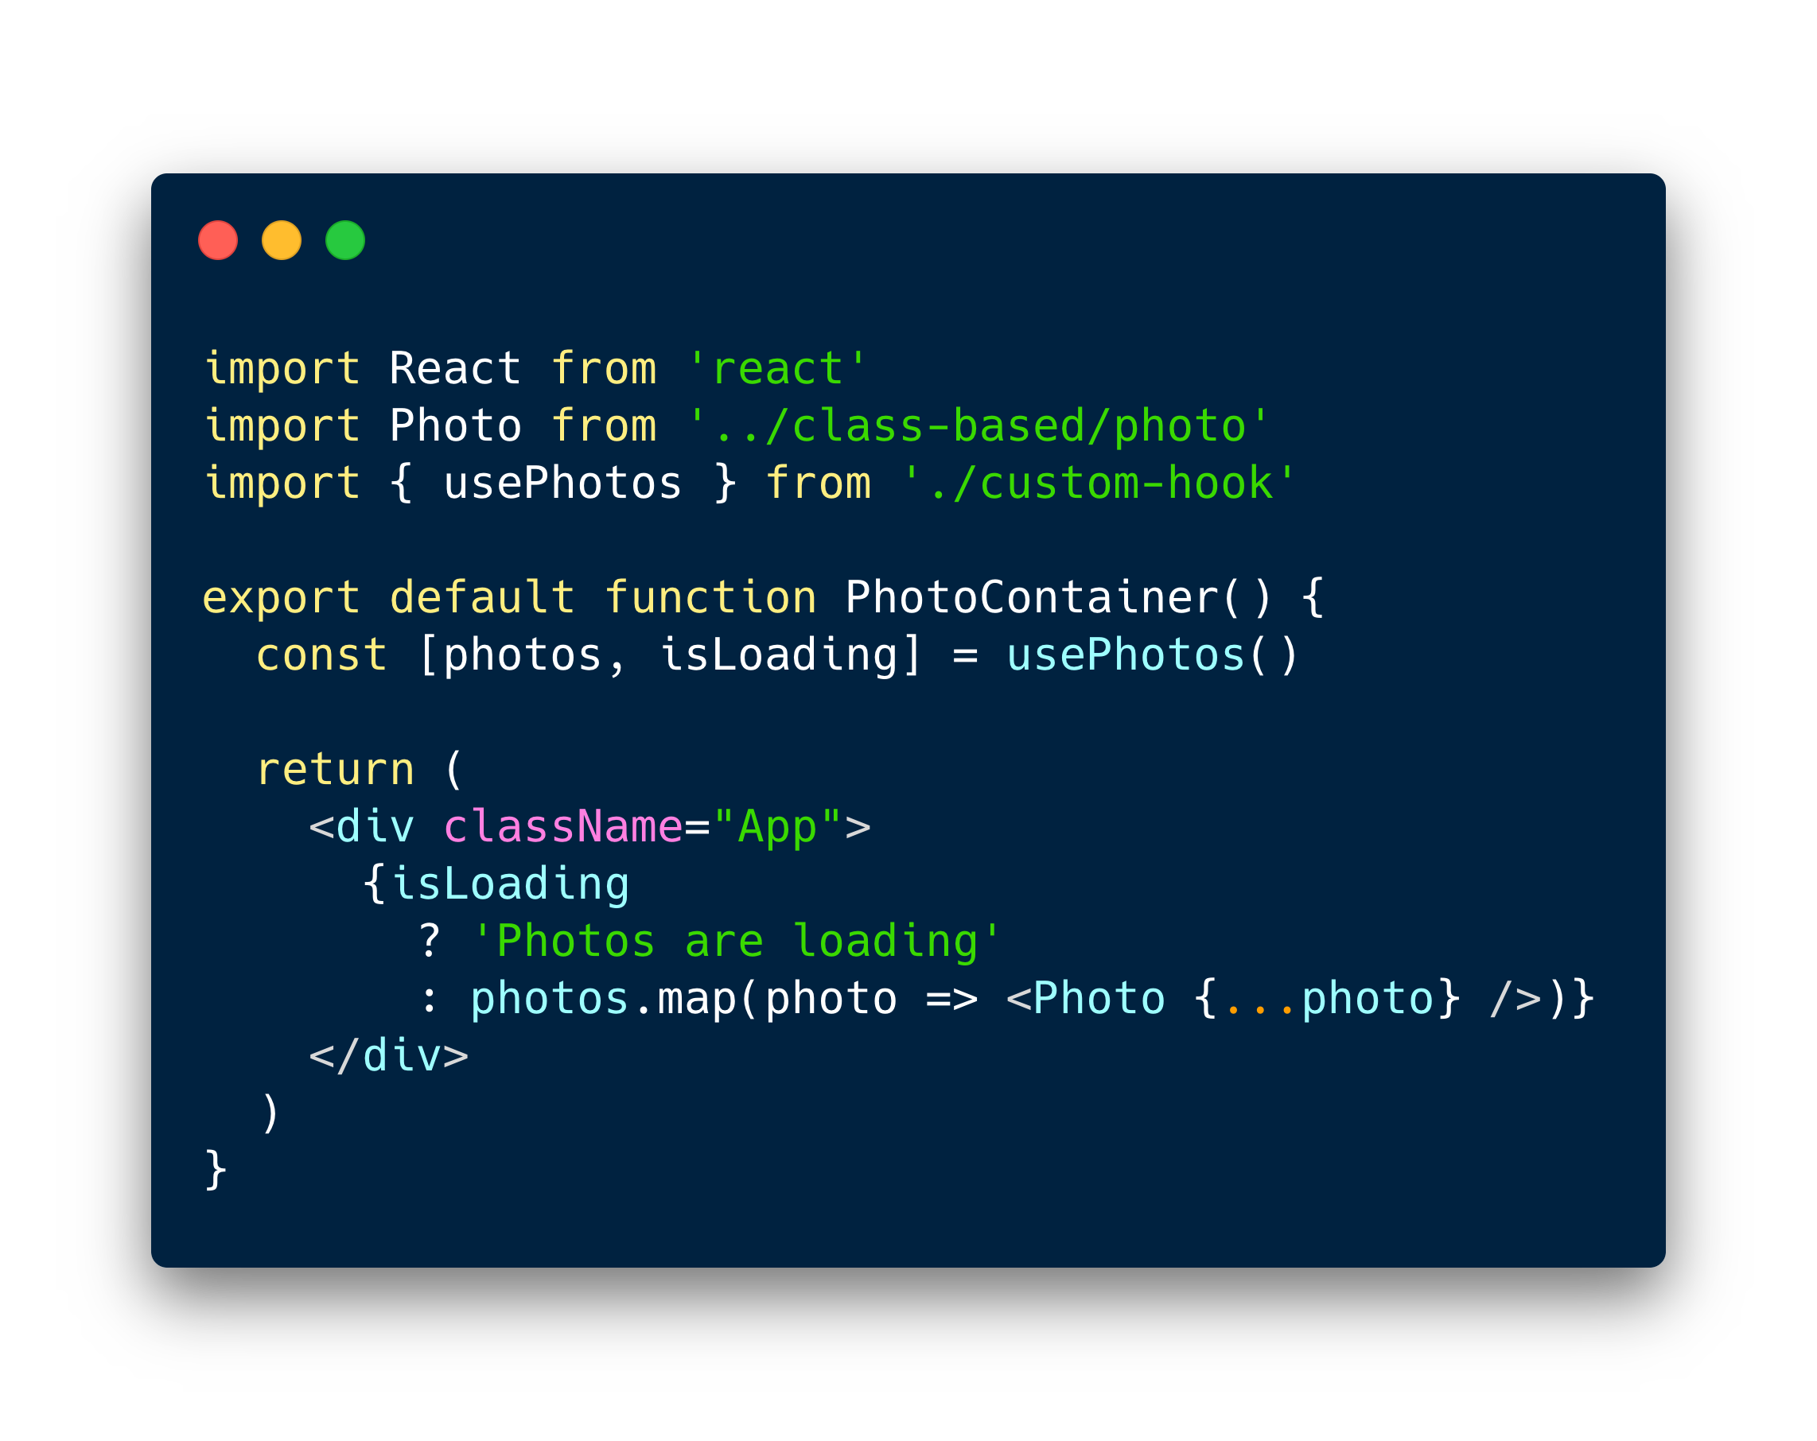
Now the photo container becomes

Slide 22
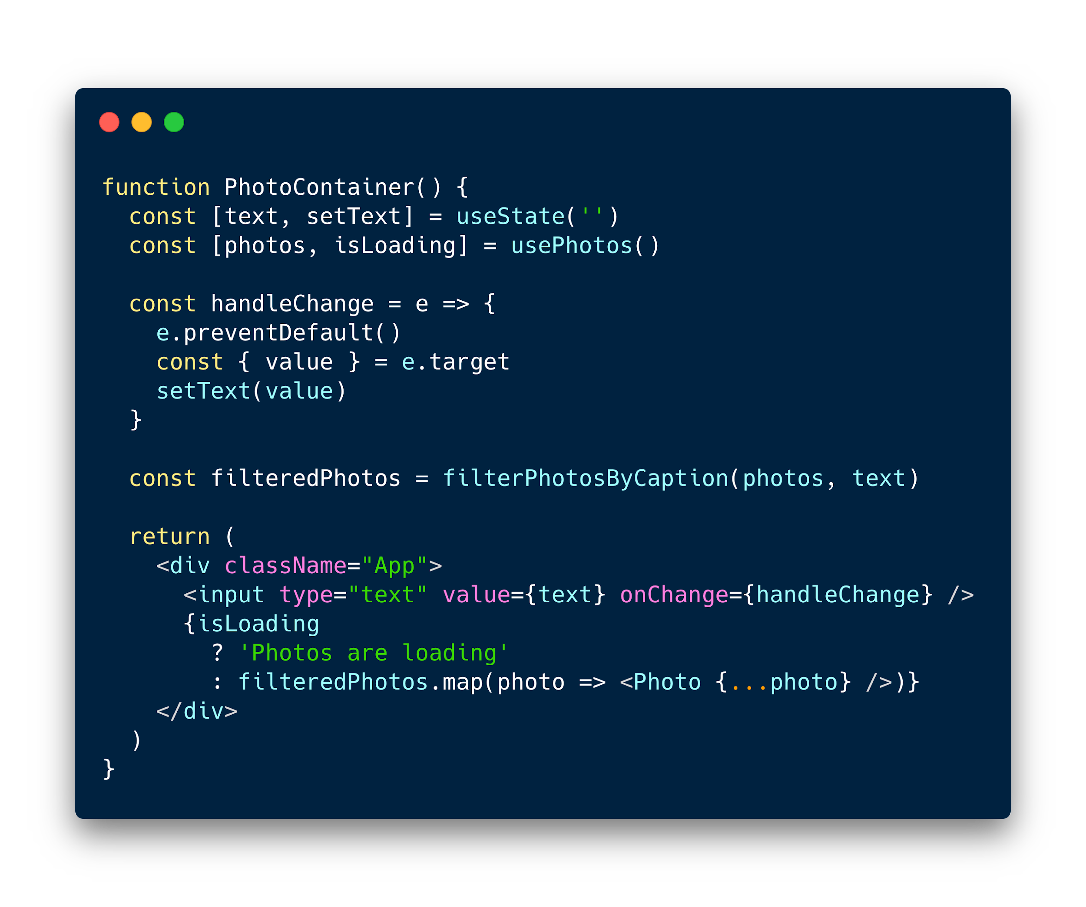
useMemo
Functions that start with “use”
Can call other hooks inside
Let’s you extract component logic into reusable functions

Slide 23
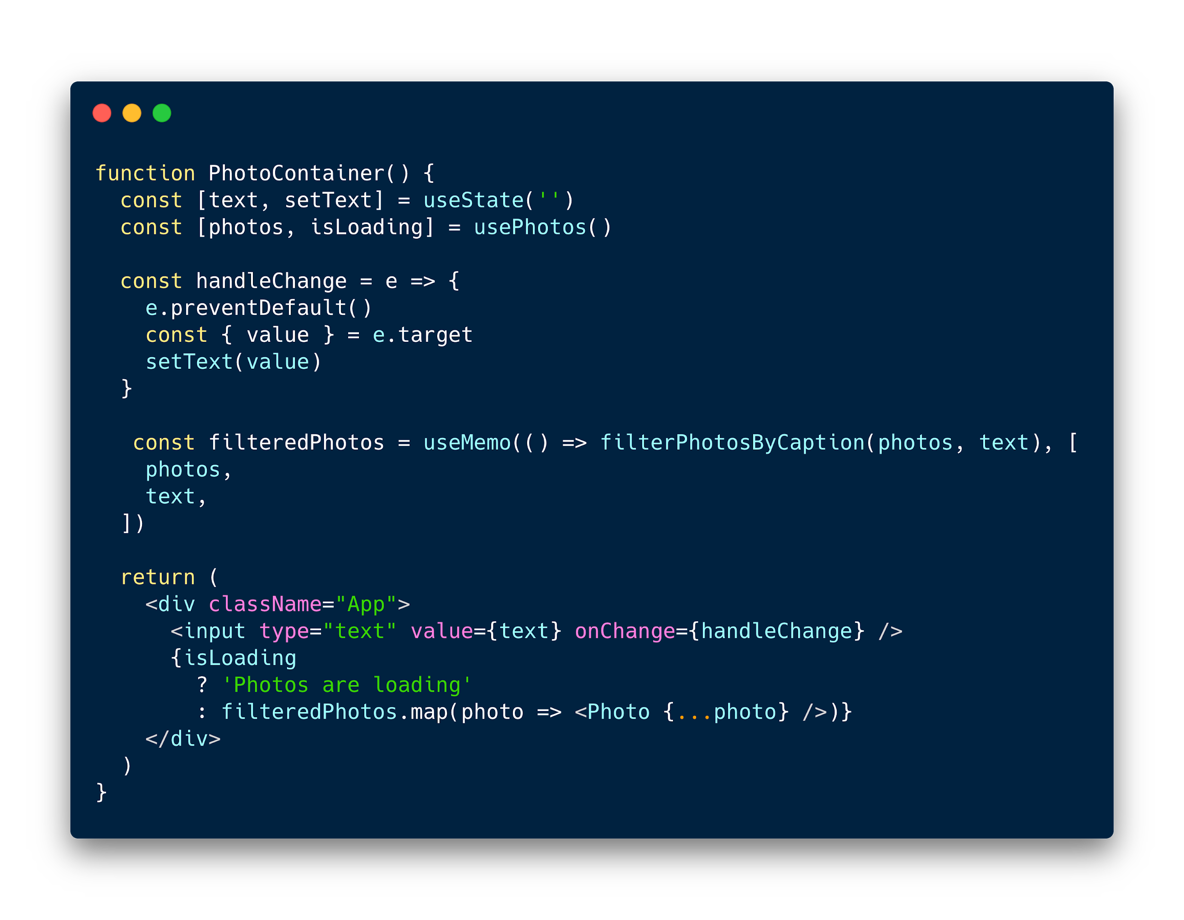

Slide 24


Thank you
digi0ps

